Slide 1
Chapter 3
SPSS

Slide 2
SPSS
We’ve covered most of chapter 3 already.
If you feel like you are very bad with SPSS, I would review it and try the exercises to practice.

Slide 3
Analyze Window
Pg 93 has some important information.
Analyze options:
Descriptives
Compare means
GLM
Mixed Models
Correlate
Regression
Loglinear
Dimension Reduction
Scale
Nonparametrics

Slide 4
Exploring Data with Graphs
Chapter 4

Slide 5
Aims
How to present data clearly
The Chart Builder
Graphs
Histograms
Boxplots
Error bar charts
Scatterplots

Slide 6
The Art of Presenting Data
Graphs should (Tufte, 2001):
Show the data.
Induce the reader to think about the data being presented (rather than some other aspect of the graph).
Avoid distorting the data.
Present many numbers with minimum ink.
Make large data sets (assuming you have one) coherent.
Encourage the reader to compare different pieces of data.
Reveal data.

Slide 7
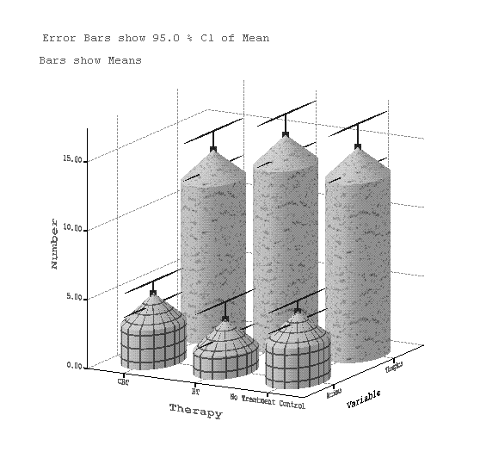
Why is this Graph Bad?

Slide 8
Bad Graphs
3D charts are bad.
Patterns (depending)
Cylindrical bars
Bad axis labels
Overlays

Slide 9
Why is this Graph Better?

Slide 10
Deceiving the Reader

Slide 11
The Chart Builder

Slide 12
Chart Builder
Gallery – different versions of each type of graph are shown
Variable list – all the variables from your data set
Canvas – graph is displayed as you create it.
Drop zones – areas where you can drop variables (blue dotted lines)

Slide 14
Warning!
When you use chart builder, you will get a “be sure to set your variables warning”.

Slide 15
Histograms: Spotting Obvious Mistakes

Slide 16
Histograms
Histograms plot:
The score (x-axis)
The frequency (y-axis)
Histograms help us to identify:
The shape of the distribution
Skew
Kurtosis
Spread or variation in scores
Unusual scores

Slide 17
Histograms
Simple – like the histograms we’ve been working with before
Stacked – histogram of two groups on top of each other
Frequency polygon – a shaded histogram
Population pyramid – instead of putting two groups on top of each other, stacks them side to side.

Slide 18
Histograms: Example
I wanted to test the Disney philosophy that ‘Wishing upon a star makes all your dreams come true’.
Measured the success of 250 people using a composite measure involving their salary, quality of life and how close their life matches their aspirations.
Success was measured using a standardised technique :
Score ranged from 0 to 4
0 = Complete failure
4 = Complete success
Participants were randomly allocated to either, Wish upon a star or work as hard as they can for next 5 years.
Success was measured again after 5 years.

Slide 21
The Resulting Histogram

Slide 22

Creating a Population Pyramid

Slide 23
Population Pyramid of Success Scores

Slide 24
Boxplots (Box-Whisker Diagrams)
Boxplots are made up of a box and two whiskers.
The box shows:
The median
The upper and lower quartile
The limits within which the middle 50% of scores lie.
The whiskers show
The range of scores
The limits within which the top and bottom 25% of scores lie

Slide 25
Boxplots (Box-Whisker Diagrams)

Slide 26
Boxplots
Simple boxplot – use when you want a single plot, but broken into categorical groups.
Clustered boxplot – useful for data with multiple categorical groups
1D plot – a box plot for one single variable

Slide 28
The Boxplot

Slide 29
The Boxplot
Stars/circles are extreme scores
You will find them outside the range of the bars on a boxplot
The middle line is the median
The box is the upper and lower quartiles (data broken into 25%)
The box to the bar is to the top and bottom quartiles
Helps you see how the data is stacked.

Slide 30
The Box Plot
* data are 3 times the interquartile range
O data are 1.5 times the interquartile range

Slide 31
Bar Charts (with errors)
The bar (usually) shows the mean score
The error bar sticks out from the bar like a whisker.
The error bar displays the precision of the mean in one of three ways:
The confidence interval (usually 95%)
The standard deviation
The standard error of the mean

Slide 32
Bar Chart Builder

Slide 33
Bar charts
Simple bar – use this chart for means of different groups
Clustered bar – use this chart for means of more than one variable with groups
Stacked bar – a clustered bar that is stacked on top of each other

Slide 34
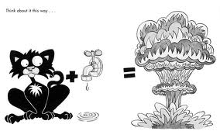
Bar Charts
3D graphs = bad.
Simple error bar – a bar chart that’s converted into a dot for the mean
Clustered error bar – same as above with multiple variables.

Slide 35
Bar Chart: One Independent Variable
Is there such a thing as a ‘chick flick’?
Participants:
20 men
20 women
Half of each sample saw one of two films:
A ‘chick flick’ (Bridget Jones’ Diary),
Control (Memento).
Outcome measure
Physiological arousal as an indicator of how much they enjoyed the film.
Chick flick data

Slide 36
Bar Chart: One Independent Variable

Slide 37
Simple Bar Charts
Y-axis is dependent variable
X-axis is independent variable (groups)
Element properties
You can plot mean, median, mode
Other types of bars (i-bar, whiskers)
Error bars – you can pick CI, SD, SE
Generally people pick one SD/SE

Slide 38
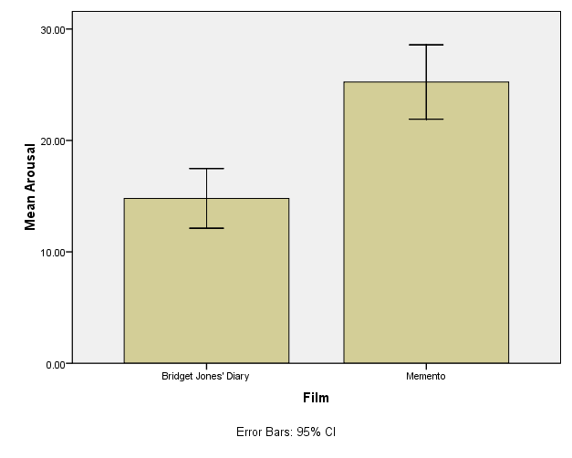
Bar Chart: One Independent Variable

Slide 39
Bar Chart: Two Independent Variables

Slide 40
Clustered Bar Charts
You can add the extra x-axis grouping variable to cluster on X set color box.
You can change the colors of the bars
Also to patterns
erin tip: black and white – journals do not like color or patterns.

Slide 41
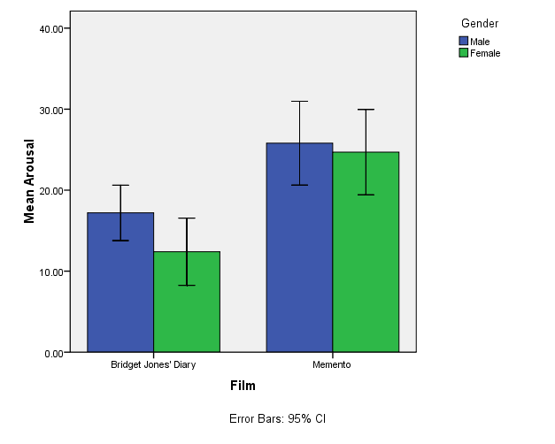
Bar Chart: Two Independent Variables

Slide 42
Bar Chart: Repeated Measures
How to cure hiccups?
Participants:
15 hiccup sufferers
Each tries 4 interventions (in random order):
Baseline
Tongue-pulling manoeuvres,
Massage of the carotid artery,
Digital rectal massage
Outcome measure
The number of hiccups in the minute after each procedure

Slide 43
Bar Chart: Repeated Measures

Slide 47
Repeated measures charts
Move all the repeated points into the y-axis box simultaneously
Use shift or control to get the variables you want
Will automatically create you a summary variable (DV) and index variable (different measurements)

Slide 48
Repeated measures charts
Click element properties
Edit properties
Axis labels (also useful if you have bad labels in SPSS for variables)

Slide 49
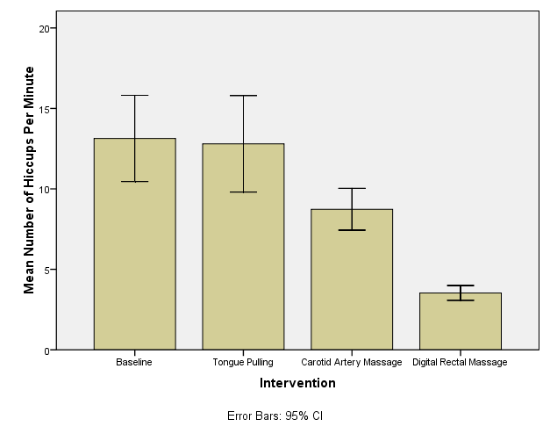
Error Bar Chart for Repeated Measures

Slide 50
Error bars
Please note the error bars for RM graphs are not correct because SPSS pretends each different measurement is a different group of people (ick).

Slide 51
Repeated measures
Multiple repeated measures IV designs you will have to graph some other way ☹
Excel!

Slide 52
Bar Chart: Mixed Designs
Is text-messaging bad for your grammar?
Participants:
50 children
Children split into two groups:
Text-messaging allowed
Text-messaging forbidden
Each child measures at two points in time:
Baseline
6 Months later
Outcome measure
Percentage score on a grammar test

Slide 53
Bar Chart: Mixed Designs

Slide 54
Mixed Bar Charts
You create these by combining all your powers into one!
Highlight all the repeated data and drop it into the y-axis.
Drop your categorical IV into the x-axis.

Slide 55
Bar Chart: Mixed Designs

Slide 56
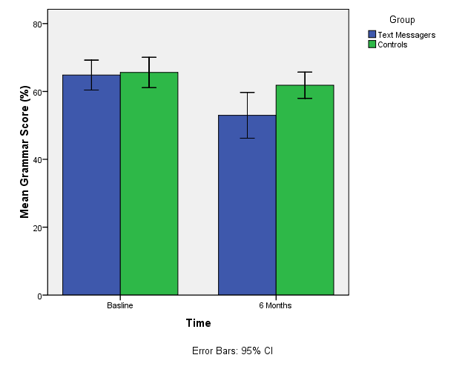
Bar Chart: Mixed Designs

Slide 57
Line Charts
Line charts are bar graphs with lines instead of bars
Simple line – means of different groups (one variable)
Multiple – means of different groups (more than one variable)

Slide 58
Scatterplots: Example
Anxiety and Exam Performance
Participants:
103 students
Measures
Time spent revising (hours)
Exam performance (%)
Exam Anxiety (the EAQ, score out of 100)
Gender

Slide 59
Scatterplots

Slide 60
Scatterplots
Simple scatter – two continuous variables
Grouped scatter – two continuous variables + 1 categorical variable
3D scatters = useful for 3 continuous variables.
Summary point plot – same as a bar chart with dots instead of bars
Simple dot plot – density plot – histogram with dots instead of bars
Scatterplot matrix – grid of scatterplots (lots variables)
Drop-line – similar to a clustered bar chart, you can use to compare means across groups.

Slide 61
Simple Scatterplot

Slide 62
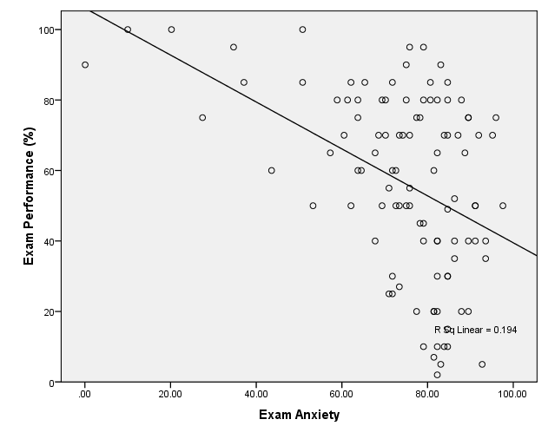
Simple Scatterplot

Slide 63
Add Fit Line
Click on the fit line box!

Slide 64
Grouped Scatterplot

Slide 65
Grouped Scatterplot
Use the “set color” drop zone for your categorical variable.

Slide 66
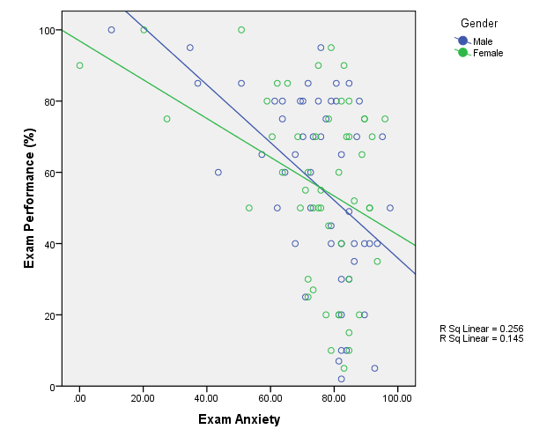
Grouped Scatterplot

Slide 67
Matrix Scatterplot

Slide 68
Matrix Scatterplot

Slide 69
Matrix Scatterplot
Useful when you want to see all the two-way combinations of variables
This will help us with data screening
Drag and drop all variables into scattermatrix box.

Slide 70
Editing graphs
Go through all the options! (page 159)
erin tip – change the automatic gray background.

